Slide 1


Introduction to Java
Confidential

Slide 2








GUVI, a proven learning ecosystem
Skilling using English & vernacular languages
Incubated by IIT-M and IIM-A
Acquired by HCL Group
600+
Corporates
3M+ learners

Slide 3
Objectives
After completing this chapter you will be able to:
  Explain IDE and Flavors of IDE
  Create Workspace, Project, class using IDE
  Build & Run Project
  Use Java API docs as reference for development.

Slide 4
What is a IDE?
An Integrated Development Environment (IDE) is a software application that provides comprehensive facilities to computer programmers for developing software with ease.
An IDE normally consists of,
Source code editor – Used for Creating/editing source code.
Compiler and/or Interpreter – Converts high level source code into low level assembly language.
Build Automation tools – Automation of packaging & deployment tools.
Debugger – Used to identify run time errors in the source code.

Slide 5
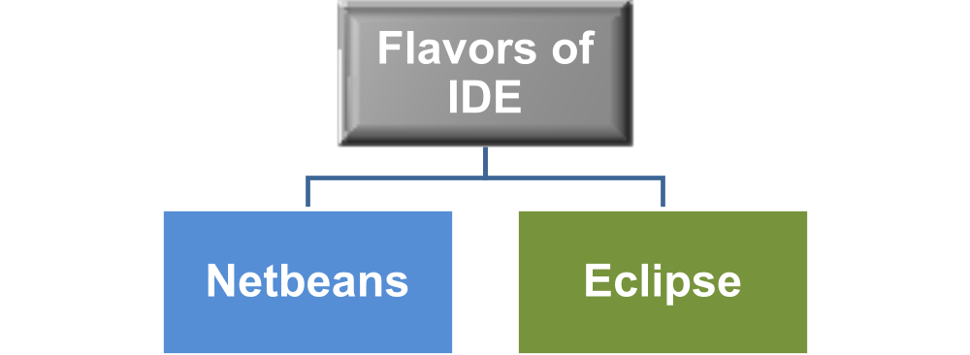
Flavors of IDE
The above two are the most commonly used IDEs for developing Java applications.
Other Examples:
  BlueJ
  Jcreator

Slide 6
Benefits of IDE
The benefits of using an IDE are
It is easy to use.
It is easy to develop complex applications using IDE.
Auto completion and generation of code can be done in some IDEs.
Code formatting becomes simpler.
Debugging code for errors is an easy task using IDEs.
Source Control Versioning can be performed using IDE.
In a nutshell, IDE is a one stop tool for building, developing and deploying applications in a fast, easy and code compliant manner

Slide 7

What is SDE?
SDE is an integrated development environment based on the eclipse platform developed by Cognizant GTO team.
SDE allows you to develop, test and deploy applications rapidly.
SDE offers a variety of tools/plugins for development and testing phase of the software development life cycle.
Eclipse is a widely used IDE in many projects. Trainees are requested to get accustomed to eclipse during the training period. All the activities should be developed using SDE.

Slide 8
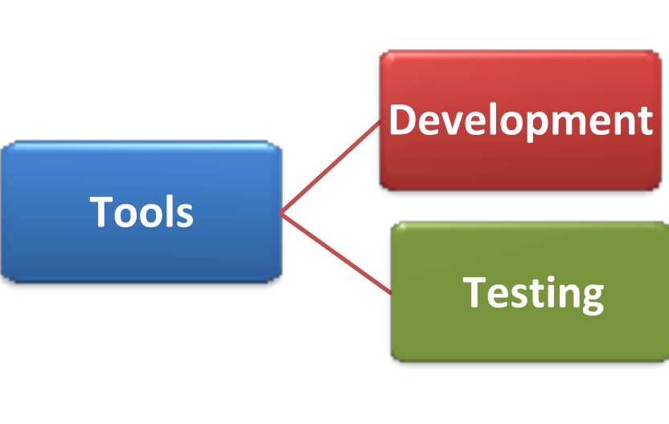

Tools & Plugins
What is a software development tool?
  Tools are either program or application that software developers use to create, debug, maintain and test applications they develop.
  Tool broad classifications:
    So what are plug-ins?
Tools used during development phase.
Example: IDE, Code analyzers, debuggers, code re-structuring tools etc.
Tools used during unit and performance testing phase.
Example:
Performance monitoring tools
Code coverage
Unit testing tools

Slide 9

What is a Plug-In?
  Plug-in are small components that provide a certain kind of service and can be configured in IDE’s.
  Typically tool builders wrap their tools in pluggable components adhering to IDE contract and release it as plug-ins.
  Example: JUnit Eclipse Plugin.
Why do we use plugins and tools?
  To improve productivity
  Improves quality
  Reduces the cost of software development

Slide 10


SDE Plugins and Tools
Code Analyzer
Testing
Build Tool
Config Mgmt
Scans java code
and identifies potential problems like performance, coding standard violations.
Examples:
PMD
CPD
Checkstyle
Automated scripts for unit testing the application, generate & publish test reports
Examples:
JUnit
Tool for building, packaging application and automating the build/deploy process
Examples:
ANT
Maven
Used for organizing & maintain the versions of software program.
Examples:
VSS
SVN

Slide 11

Workspace and Project
What is a project?
  A project is a repository which stores java classes and other related files needed for building the application.
  In the repository developers can develop stand alone or web applications
What is a workspace?
  A workspace is a space where one or more projects is created. It is a wrapper is used for managing the projects and they are typically stored as a directory in your operating system.
Workspace is like a box/container where multiple projects are created.
Project
1…n
Workspace

Slide 12
Types of Project
Listed below are some common types of project
Java project is used to develop a stand alone java application. It generates a Java archive file which is a collection of class files and images.
This is used to develop a web application. It generates a War file which is a collection of class, JSP, JAR and XML files.
This is used to develop an enterprise application. It generates an EAR file which is a collection of JAR, WAR and EJBs.
Java Project
Dynamic Web Project
J2EE Project
JAR - Java Archive
WAR - Web Archive
EAR – Enterprise Archive

Slide 13
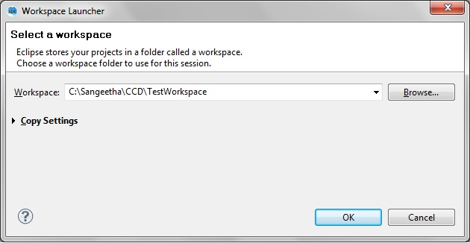
Lend a Hand - Creating Workspace
Let us all create a workspace
  When Eclipse is started, a workspace can be selected by using the Browse Button.
How to switch workspace?
  User can switch from one workspace to another using the
  File → Switch workspace option.
NOTE: If the folder selected does not have a workspace the SDE will automatically create a new workspace.

Slide 14
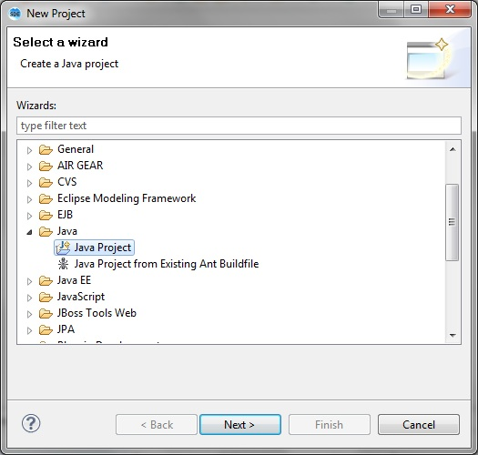
Lend a hand - Creating a Project
Let us now create a project
    Click CTRL+N (or) Choose File → New → Project and select the appropriate project (In our case it is Java project)
  Click on Next, enter the Project Name and click on Finish.
  The Java project will open in the Java Perspective

Slide 15
What is a Package?
What is a package?
  A package is a namespace that logically group a set of related classes.
  Conceptually, package is similar to the sub folders on the computer where we keep HTML pages in one folder, images in another etc.
  Since the project contains huge number classes, packages are used to organize these classes based on their functionalities.
Package is a folder where related java files are placed.
Example: In a banking application all savings account related java files will be placed under com.savings package and demat account files will be placed in com.demat package.
Java Files
1…n
Package

Slide 16
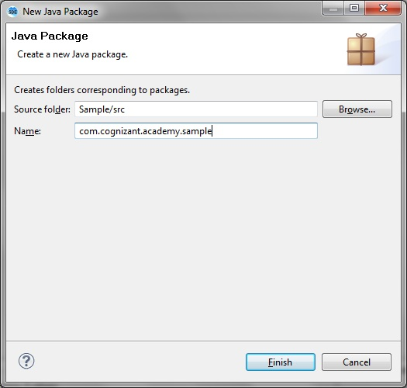
Creating a Package
How to create a package?
  Right click on the project, select New → Package and enter a fully qualified package name in the dialog box
  Example : com.cognizant.academy.sample
  Click on Finish to add the package to the selected project

Slide 17
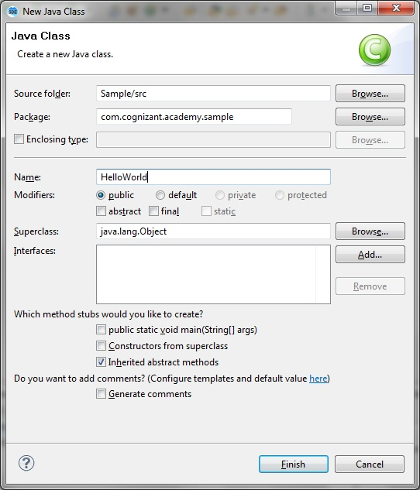
Creating a Class
How to create a class?
  Select Package name.
  Right click the package and select New → Class.
  Enter the Key information such as Class Name.
  Click on Finish to create a new class.
  The main method can be automatically generated by clicking on the checkbox “public static void main (String args[])”

Slide 18
Writing a program
Hurray !!
We are all set to write a program
Let us all develop a small program to print the words “Hello World” in the console.

Slide 19
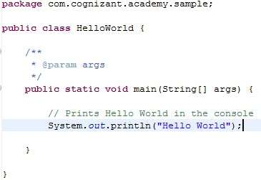
Writing a program

Slide 20
Building a program
What does build a program mean?
  This is nothing but compilation where the .java files created by the developer is compiled and a .class file is created automatically by the compiler. This .class file is loaded to run the class
  The Java files are compiled by the build process in SDE.
  SDE provides facilities for both automatically building a java file and building it manually. In automatic build, all java files are recompiled when a resource is saved.
Manual Build:
To manually build a project, select the project menu and click on Project → Build Project

Slide 21
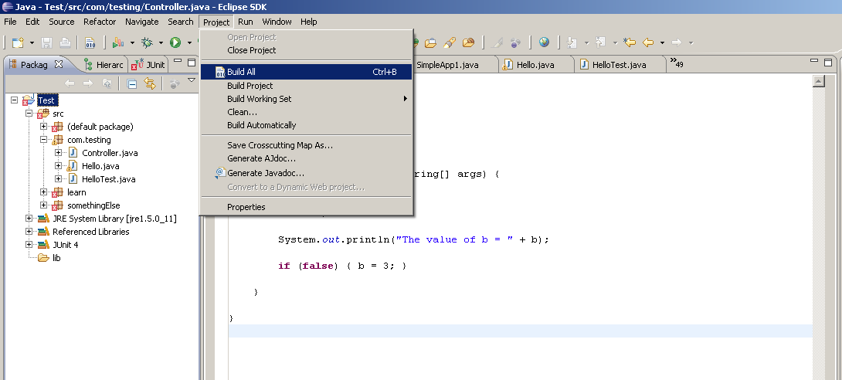
Lend a hand - Building a program
Automatic Build:
Let us all enable automatic build now.
To enable automatic build for a project, click on menu
Project → Build Automatically

Slide 22

Executing a program
To run the Java class, right click on the class, select
  Run As → Java Application
The words “Hello World” is printed in the console
Alternatively, the Run icon on the toolbar can be clicked.
The launch configuration dialog opens when the program is run for the first time.
You can also specify arguments, JRE and classpath settings for your launch configuration
Clicking Run invokes the main method of the class

Slide 23
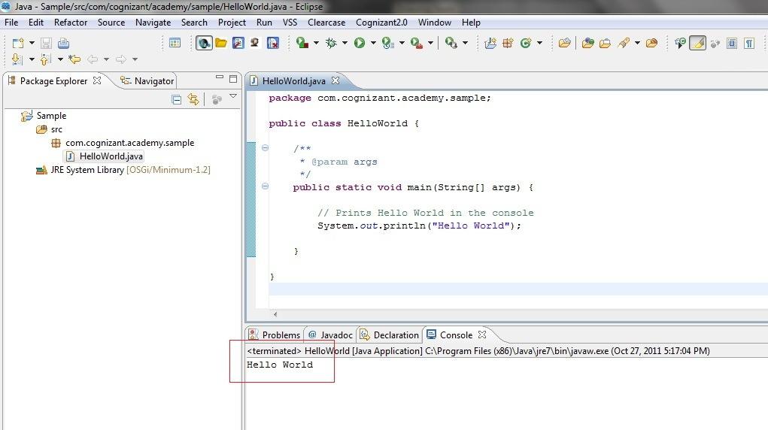
Program Console
  Program Output in the console

Slide 24


Problem in sharing files?
Tim a java developer has developed an application using eclipse.
He has developed the application in 3 weeks. Ron another java developer wants to upgrade the application developed by Tim. He reaches Tim and asks him the source files. Tim zips all the files and shares it with Ron. Ron spends 3 hours to unzip the files, configure the eclipse workspace, creating project and fix all the configuration issues.
  Assume Tim has to share this with 100 developers. Everyone will end up spending 3 hours burning 300 hours.
  HOW CAN THIS BE EFFICIENTLY DONE?
  Using Import/export feature of IDE you can get this done in few seconds.

Slide 25
Exporting a project
Exporting a project:
The easiest way to share your projects to the rest of the world is through compressing the project files into an archive file, a process which Eclipse performs automatically using the Export Wizard
The projects can be exported as an archive file (.zip or .tar format) or an application file (.jar, .war, .ear)
Steps to Export a project: (Refer to screenshots in next slide)
Step 1: Choose the project and select File → Export

Slide 26
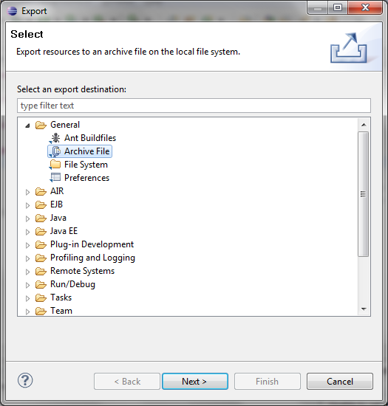
Exporting a project
Step 2: Choose Archive file (If you want to save the project in a .zip format) and click on next

Slide 27
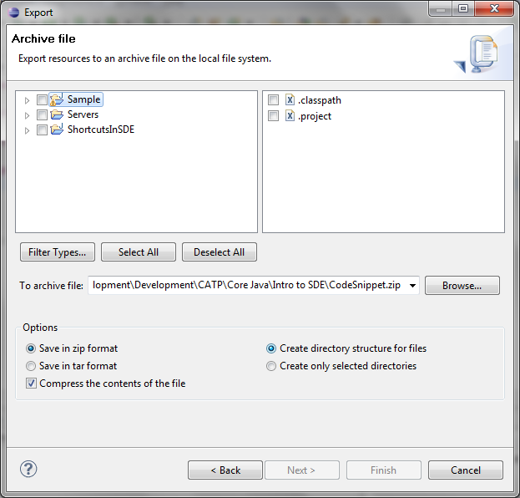
Exporting a project
Step 3: Choose the required folders, specify the file name and click on Finish
  Congrats !! Your file has been exported to a .zip file

Slide 28
Importing a project
Importing a Project:
  Exported projects can be imported into Eclipse using the Import Wizard.
Flavors of importing:
The files that can be imported are
    Archive Files (.zip)
    Projects from CVS Repository
    Existing Projects into Workspace
      Web Application - .war
      J2EE application - .ear
      Client/EJB file - .jar
    File System

Slide 29
Lend a hand – Importing a project
Let us all import the below project
<Refer to the “Resources” section of this Session for the attachment “CodeSnippet.zip”>
The imported project will be used in the upcoming slides to explain about the Shortcuts in SDE.
The src folder in the project contains the required java files
  NOTE: The zip needs to be saved in local file system before being imported in eclipse.

Slide 30
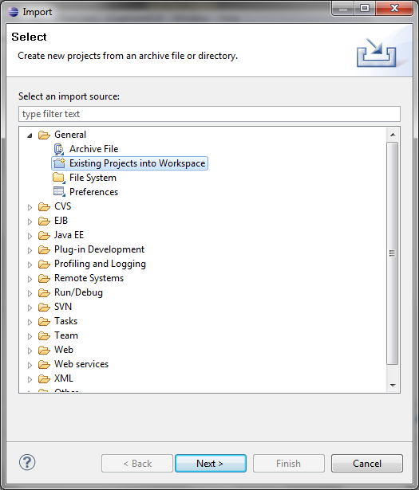
Lend a hand – Importing a project
Step 1:
Click on File → Import,
Choose “Existing Projects From Workspace” and click on Next

Slide 31
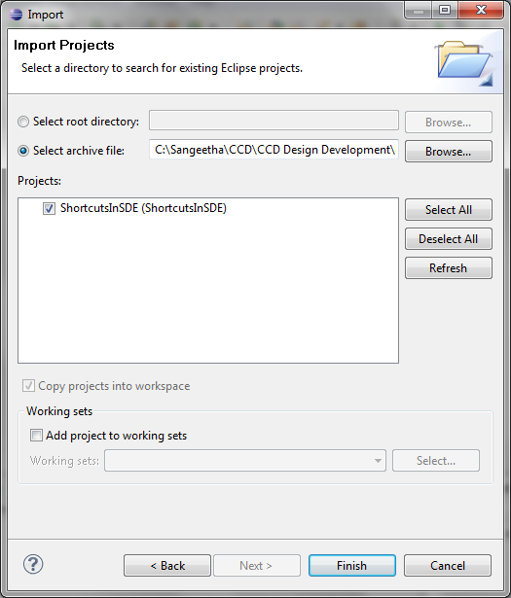
Lend a hand – Importing a project
Step 2:
In the “Select Archive File” text box, browse and select the local File (that was downloaded in your local system) and click on “Finish” to import the project into your workspace.

Slide 32

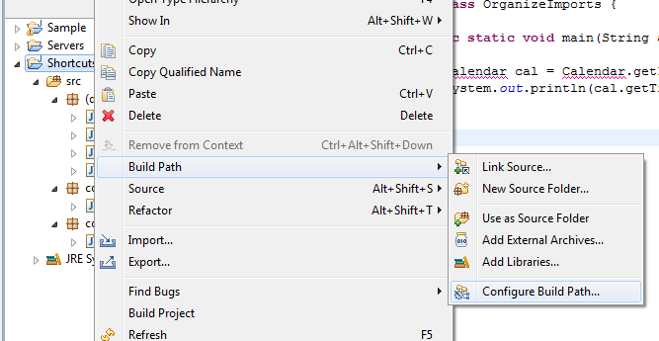
Lend a hand – Importing a project
Do you have errors in your project?
  There might be some Build Path issues
  The JDK/JRE settings and the libraries required for running the project are available in the Build Path settings page
  Let us change the Build Path now (NOTE: Do this only if you have build path errors)
  Step 1: Right Click on the project and select
  Build Path → Configure Build Path

Slide 33
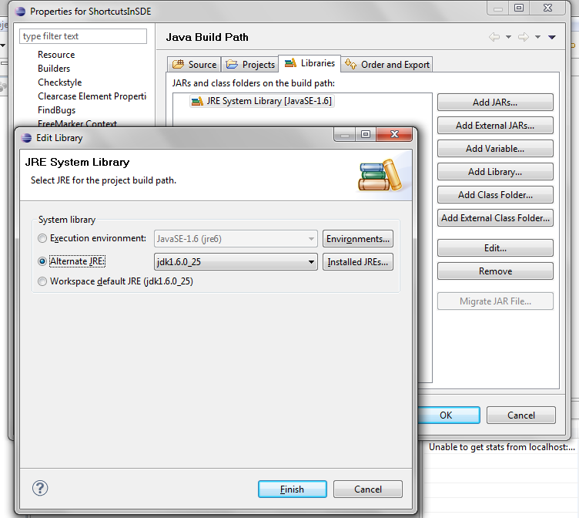
Lend a hand – Importing a project
Step 2:
  Go to the Libraries tab, click on Edit after choosing the system library and choose the appropriate JDK for your application. Click on Finish.
The library Setting being done here corresponds to the Classpath setting that was done in “Intro to Java” session to execute the class files
A compilation error will be present in OrganizeImports.java. This has been intentionally added to explain Imports in the forthcoming slides

Slide 34

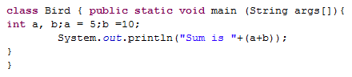
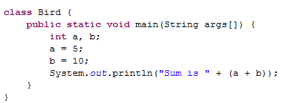
Shortcuts in SDE – Auto Format
SDE offers a variety of tools and shortcuts to make coding easier. Listed below are some of the tips to use SDE effectively.
Let us all work together to understand the shortcuts in SDE.
Code Formatting:
  Code Formatting refers to the alignment of code in a proper manner such that it is readable and maintainable by other people.
Unformatted Code
Formatted Code
Formatting of source code has been a concern raised by many Cognizant customers. Developers need to ensure that the code they develop is properly formatted

Slide 35
Shortcuts in SDE – Auto Format
SDE offers a variety of tools and shortcuts to make coding easier. Listed below are some of the tips to use SDE effectively.
Auto Format:
Formatting of code can be done automatically during every save Action. To set AutoFormat, navigate to
Windows→Preferences→java→Editor→Save Actions
and check the Format Source Code option.
  Try It out: Open UnformattedCode.java and click on ‘save’ to format the code.
  Alternatively, CTRL+Shift+F can be used

Slide 36
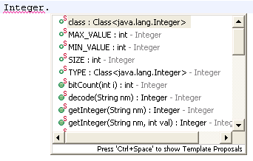
Shortcuts in SDE – Code Assist
Code Assist:
The code assist will display valid classes, methods, fields and variables. Press the CTRL+Space keys to list all the valid methods.
  Try it out: In CodeAssist.java class, inside the sysout block, type Integer. and analyze the options that appear in SDE (as shown above). Choose MAX_VALUE from the various options and execute the program.

Slide 37
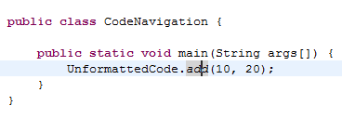
Shortcuts in SDE-Code Navigation
Code Navigation:
Press on F3 to navigate to the appropriate methods implementation (or) declaration if it is a interface.
Try it out:
In CodeNavigation.java, place the cursor on the word “add” in line 4.
Press F3
The control goes to the add method in UnformattedCode.java class.
Press on F3 after placing the cursor as shown in picture

Slide 38
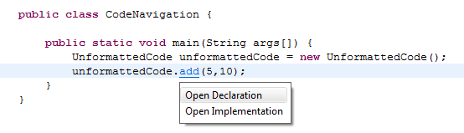
Shortcuts in SDE-Code Navigation
Code Navigation for Interface:
  If the UnformattedCode.java is an interface, then place the cursor on “add”, press Ctrl button and click on Open Implementation.
The concept of interface will be explained in future sessions. Hence demo for this will be done after the Interface session

Slide 39
Shortcuts in SDE – Organize Imports
Organize imports:
SDE simplifies the task of finding the correct import statements to use in java code. This also removes the unnecessary imports added by the programmers in the code which is not used in the program.
How to organize imports?
Right click and Select Source → Organize Imports (or)
Shortcut Key: Ctrl+Shift+O
  Try it out:
  Associates can notice the Calendar object imported automatically and the “java.lang.Integer” import being removed automatically
  In OrganizeImports.java, press Ctrl+Shift+O to import the Calendar util and remove the unwanted Integer import.

Slide 40
Shortcuts in SDE – Setting Project Build path
Project Properties
Various properties of the project can be set in the Project properties window. Some examples are Build Path, Compiler Setting, External JARs and PMD.
  To open the properties dialog box.
Right click the project → Select Properties.
  Choose BuildPath in Properties window to set the BuildPath
  Addition of External JARs:
  There might be some instances when we will have to add JAR files (which are not present in JRE) for our project to compile and execute correctly.
  Example: Junit.jar needs to be added for developing Junits.

Slide 41
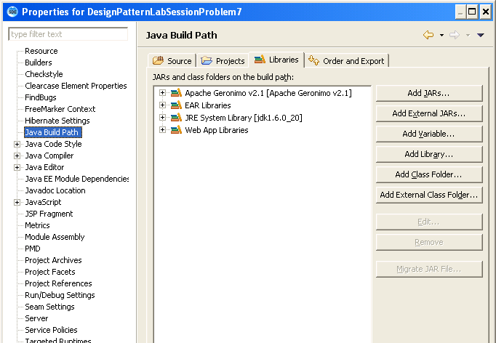
Shortcuts in SDE – Setting Project Build path
  To add an external JAR,
  Click on “Add External JARs..” choose JAR file location and click on OK.
The JAR file should have been previously downloaded and saved in the local file system

Slide 42
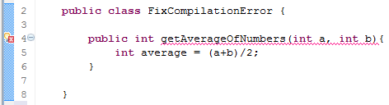
Shortcuts in SDE – Fixing Compilation Errors
Compilation Errors in SDE:
  SDE works wonders with displaying the compilation errors !!
  You do not have to wait till you run the program to know about the compilation errors in your program.
  SDE makes your job easier by displaying the compilation errors as you type. In addition, SDE also provides you suggestions on how to fix the compilation error.
  Example:
  Create a new java class called FixCompilationError.java with the below code

Slide 43
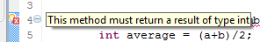
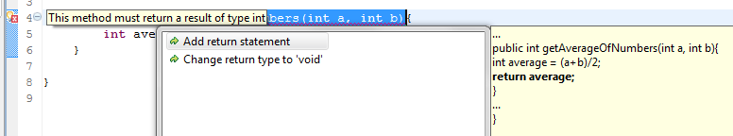
Lend a hand – Fixing Compilation Errors
Demo on Fixing compilation errors:
To view the compilation error, point to the Bulb icon on the left side of the editor.
2. Click on the bulb icon to know the suggestions provided by SDE
3. Choose one of the suggestions if they are appropriate or perform your own fix to avoid the compilation error
Voila !! Your compilation error has been fixed !!

Slide 44

A Problem statement
Tim a java developer when developing an application wanted to reverse a String. He was breaking his head to build a logic to achieve it.
Ron another Java developer gave a tip to Tim. Now Tim was able to solve the problem in less than a minute.
How did Tim achieve it ?
Tim referred the Java API documentation and was able to solve the problem in a minute.

Slide 45


Tip for developers.
If you do not remember the syntax of an Java API !!

Slide 46
How to refer Java API’s?
  The developers need not remember the syntax of inbuilt java methods. They can use Javadoc API available on the internet to know the available API and their syntax.
  The URL to view the java API document is
  http://docs.oracle.com/javase/6/docs/api/
  Example:
  To know the API that can be used on a StringBuffer, you can refer to the StringBuffer API’s which will list down all methods, their parameters and their return types.

Slide 47
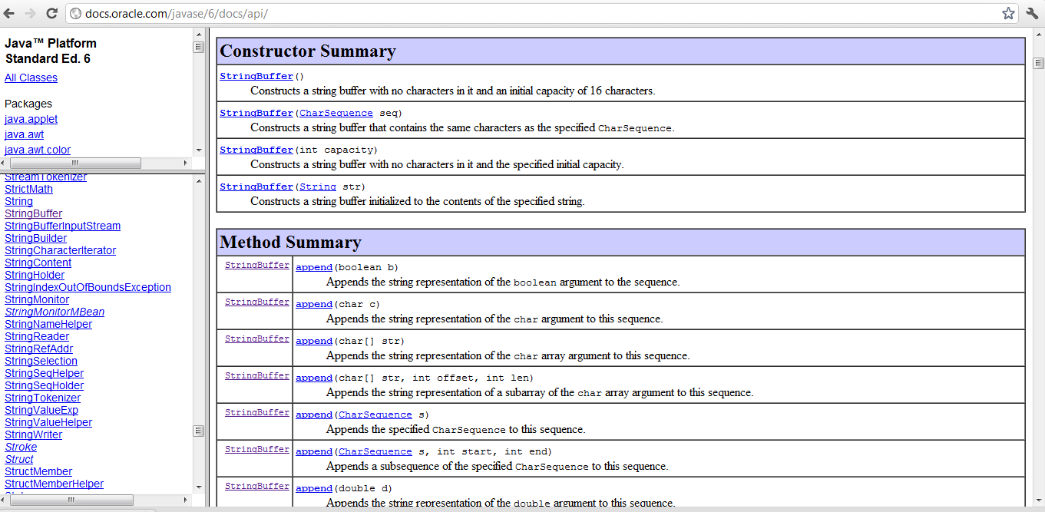
Java API Documentation Screen shot
  Sample screen shot of the StringBuffer API
List of in built Java Objects.
The selected Java Objects API’s will be listed in this frame.

Slide 48

Time To Reflect
Associates to reflect the following topics before proceeding.
What is SDE?
What are the flavors of IDE available?
What is the short cut to organize imports?
What feature will you use to share your source code with other developer?

Slide 49
Hands on Exercise
Create a Class “Calculator.java” in “com.cognizant.academy.sample” package
The class should have two integer variables “operand1” & “operand2”.
Create a method “displayOperand” and add the logic of displaying the value of variables in the below format,
    “The value of operand 1 is <operand 1 Value>”
    “The value of operand 2 is <operand 2 Value>”
Create a main method
  Create instance of Calculator.java
  Set the value of “operand 1” as 89 and “operand 2” as 34.
  Invoke the method displayOperand
The message should be displayed as mentioned in point # 2.

Slide 50
Thank You!

